Slide 1
ARCHITECTURE PACK · v0.2
Aara
Teams Aggregator Bot
A Microsoft Teams bot — hosted on Azure, powered by AskAT&T, and woven across the Microsoft 365 estate — that captures summary, action items, decisions, path forward and follow-ups from designated channels and @mentions.
01
02
03
04
System Architecture
Network & Security
Data Flow
Deployment View
All components, zones, data flow
Identity, perimeters, controls, compliance
End-to-end sequence of a digest run
Regions, SKUs, scaling, DR, CI/CD
Raja · Product · May 2026 · Confidential

Slide 2
How to read this pack
Four views, one system. Each diagram zooms in on what its audience cares about.
01
System Architecture
02
Network & Security
for Everyone
for IT / Security review
Four trust zones: Users → Microsoft 365 → Azure → AT&T network
Every component the system depends on
High-level data flow between zones
Color-coded by category: compute, data, security, AI, observability
Identity perimeter (Entra ID, RSC, Managed Identity)
Network perimeters: Internet → M365 → Azure VNet → AT&T
Private Endpoints, ExpressRoute, mTLS path to AskAT&T
Compliance band: NIST 800-53 R5 mapping
03
Data Flow / Sequence
04
Deployment View
for Engineering
for Engineering + Ops
End-to-end trace of one digest run
9 lifelines from channel member to Adaptive Card reply
Capture → Extract → Persist → Deliver → Interact phases
Trigger paths for both on-demand and scheduled digests
Azure regions (East US 2 primary, West US 3 DR)
Specific SKUs, autoscale, zone redundancy
Subnet layout, Private DNS, ExpressRoute
CI/CD pipeline, IaC modules, secrets approach

Slide 3
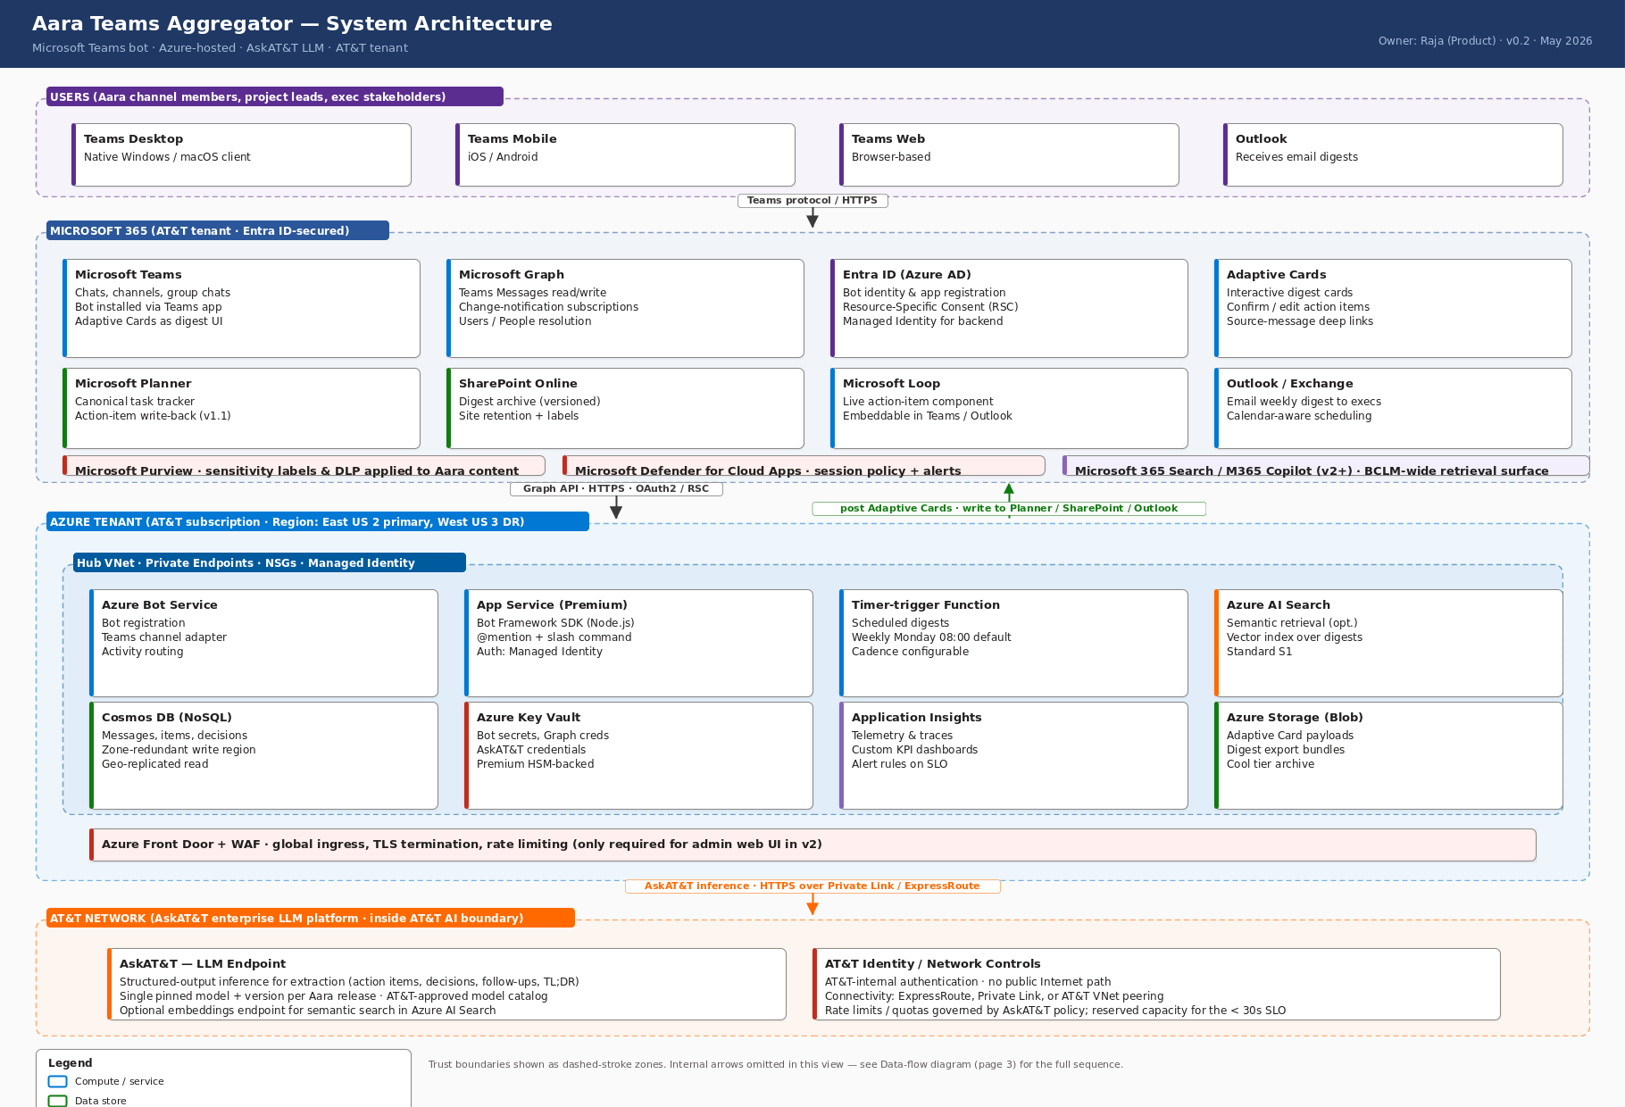
01
System Architecture
All components · all zones · macro view
Four trust zones top-to-bottom. Note the LLM hop on the bottom goes via private network to AskAT&T; no public-Internet AI providers are reachable.
Notes:
View 01: System Architecture Four trust zones top-to-bottom. Note the LLM hop on the bottom goes via private network to AskAT&T; no public-Internet AI providers are reachable.

Slide 4
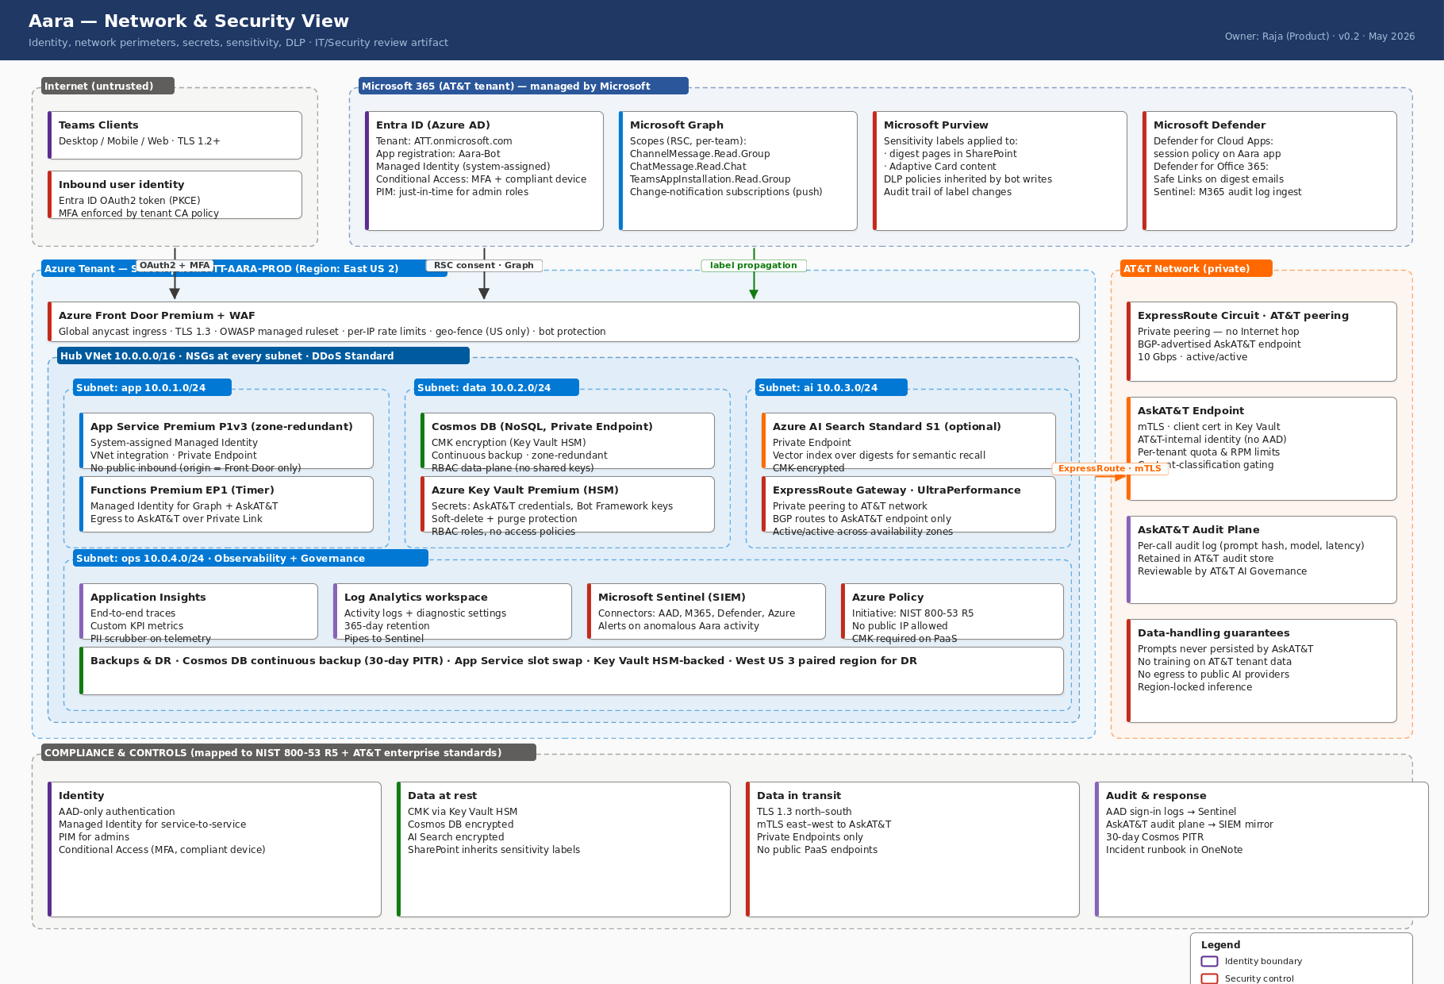
02
Network & Security
Identity · perimeters · controls · compliance
Read left-to-right: untrusted Internet → managed M365 → AT&T-owned Azure → private AT&T network. Compliance band at bottom maps each control family to NIST 800-53 R5.
Notes:
View 02: Network & Security Read left-to-right: untrusted Internet → managed M365 → AT&T-owned Azure → private AT&T network. Compliance band at bottom maps each control family to NIST 800-53 R5.

Slide 5
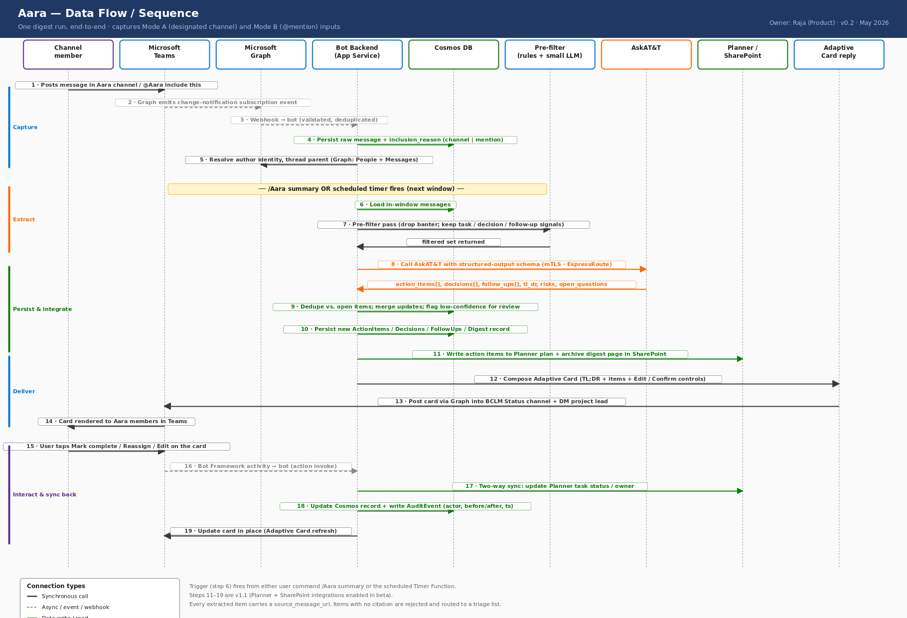
03
Data Flow / Sequence
One digest run, end-to-end
Steps 1–5 are continuous capture. Step 6 is the trigger (user command or scheduler). Steps 7–13 are extract + deliver. Steps 14–19 are user interaction and write-back to Planner.
Notes:
View 03: Data Flow / Sequence Steps 1–5 are continuous capture. Step 6 is the trigger (user command or scheduler). Steps 7–13 are extract + deliver. Steps 14–19 are user interaction and write-back to Planner.

Slide 6
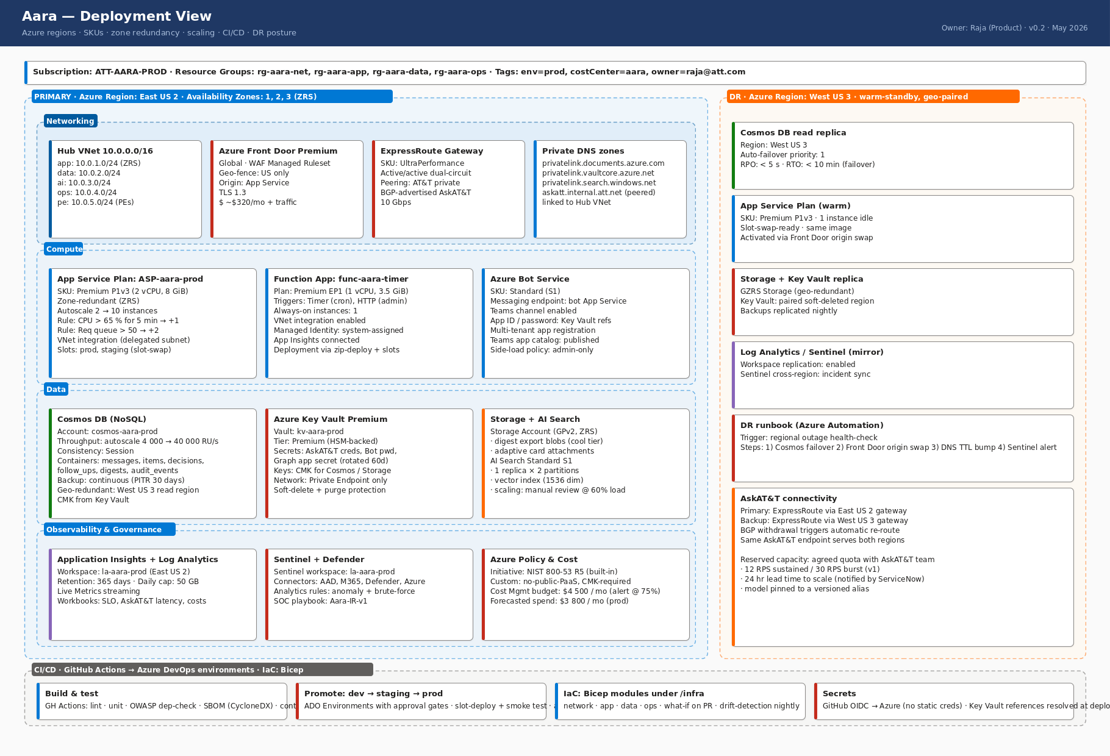
04
Deployment View
Regions · SKUs · scaling · DR · CI/CD
Left: primary region (East US 2) with full topology. Right: DR posture (West US 3, warm-standby). Bottom: CI/CD with OIDC and IaC. Cost forecast: ~$3.8k/mo at prod.
Notes:
View 04: Deployment View Left: primary region (East US 2) with full topology. Right: DR posture (West US 3, warm-standby). Bottom: CI/CD with OIDC and IaC. Cost forecast: ~$3.8k/mo at prod.

Slide 7
Stack reference
Concrete components in v1; v1.1 and v2 phases noted.
Microsoft 365 (v1)
Azure (v1)
Teams (chats, channels, group chats)
Microsoft Graph + change notifications
Entra ID + Resource-Specific Consent
Adaptive Cards (digest UI)
Purview (sensitivity labels)
Defender for Cloud Apps + DLP
Azure Bot Service (Standard)
App Service Premium P1v3 (zone-redundant)
Functions Premium EP1 (Timer)
Cosmos DB autoscale 4k–40k RU/s
Key Vault Premium (HSM, CMK)
AI Search Standard S1 (semantic)
App Insights + Log Analytics + Sentinel
Front Door Premium + WAF
AT&T network
M365 v1.1 / v2
AskAT&T enterprise LLM endpoint
ExpressRoute UltraPerformance gateway
Private peering (active/active)
Reserved capacity: 12 RPS sustained / 30 RPS burst
mTLS, AT&T-internal identity
Per-call audit plane (model, latency, prompt hash)
Microsoft Planner (action-item write-back) — v1.1
SharePoint Online (digest archive) — v1.1
Microsoft Loop (live components) — v1.1
Outlook / Exchange (email digest) — v1.1
OneNote, Lists, Power Automate — v2
M365 Search / Copilot agent — v2+

